Slide 2
THE DISCIPLES RELATIONSHIP:
TO HIMSELF
An Athlete
A Soldier
TO HIS LORD
The Potter and the Clay
The Vine and the Branches
A Child of God
TO HIS BRETHREN
A Member of the Body
“My Brother’s Keeper”
A Servant
TO THE WORLD
Strangers & Pilgrims
Salt & Light
An Apologist
Fishers of Men

Slide 3
LESSON 9: A Servant The Disciple’s Greatness
“…whoever desires to become great among you, let him be your servant. And whoever desires to be first among you, let him be your slave.” (Matt. 20:26-27)

Slide 4
A Servant – Outline for Lesson 9
What does it mean to be a servant?
Definition
“Greatness” in the Kingdom
The example of Christ
How to be a Good Servant
Attitude
Awareness
Action
Availability

Slide 5
A Servant – Definition and “Greatness”
Matt. 20:17-28 (Mark 10:32-45)
Gk. “diakonos” (vs. 26, 28v) – servant/minister
one who executes the commands of another, especially a master; attendant
Rom. 1:1; Phil. 2:7; 2Tim. 2:24; Act. 6:2 (sim.)
Gk. “doulos” (vs. 27) – slave/servant
one who gives himself up to another’s will; devoted to another to the disregard of one’s own interests;
Rom. 15:8; 1Tim. 4:6; 1Pet. 4:10; Gal. 5:13 (sim.)

Slide 6
A Servant – Definition and “Greatness”
“…whoever wishes to become great among you shall be your servant, and whoever whishes to be first among you shall be your slave; just as the Son of Man did not come to be served, but to serve, and to give His life a ransom for many.” (Matt. 20:26-28)
The worldly definition of “greatness” vs. God’s definition of “greatness”

Slide 7
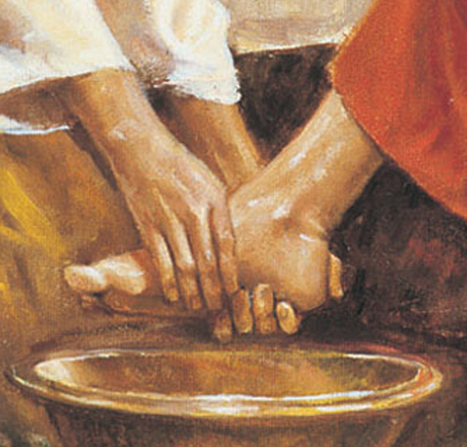
Jesus, the Great Example
“Do you know what I have done to you? You call Me Teacher and Lord; and you are right, for so I am. If I then, the Lord and the Teacher, washed your feet, you also ought to wash one another’s feet. For I gave you an example that you also should do as I did to you.” (John 13:12-15)
“For who is greater, the one who reclines at the table or the one who serves? Is it not the one who reclines at the table? But I am among you as the one who serves.” (Luke 22:27)

Slide 8
Jesus, the Great Example
Phil. 2:1-11
“…who, although He existed in the form of God, did not regard equality with God a thing to be grasped, but emptied Himself, taking the form of a bond-servant, and being made in the likeness of men…” (vss. 6-7)
“He humbled Himself by becoming obedient to the point of death…” (vs. 8)
God highly exalted Him, and bestowed on Him the name which is above every name…” (vs. 9)

Slide 9
How to Be a Good Servant - Attitude
Phil. 2:1-11
Humility
“make my joy complete by being of the same mind, maintaining the same love, united in spirit, intent on one purpose” (vs. 2)
“Do nothing from selfishness or empty conceit, but with humility of mind regard one another as more important than yourselves.” (vs. 3)
“Humility is not thinking less of yourself, it's thinking of yourself less.” -C.S. Lewis

Slide 10
How to Be a Good Servant - Attitude
Love, Kindness, Gentleness…
“with all humility and gentleness, with patience, showing tolerance for one another in love…” (Eph. 4:2)
“…as those who have been chosen of God, holy and beloved, put on a heart of compassion, kindness, humility, gentleness and patience; bearing with one another, and forgiving each other, whoever has a complaint against anyone; just as the Lord forgave you, so also should you.” (Col. 3:12-13)

Slide 11
How to Be a Good Servant - Attitude
Is this a “favor for favor”?
What if they don’t display any appreciation?
What if I don’t think they deserve for me to be loving, kind, patient…?
“Slaves, in all things obey those who are your masters on earth, not with external service, as those who merely please men, but with sincerity of heart, fearing the Lord. Whatever you do, do your work heartily, as for the Lord rather than for men, knowing that from the Lord you will receive the reward of the inheritance.” (Col. 3:22-24)

Slide 12
How to Be a Good Servant - Awareness
Aware of our own talents (Rom. 12:6-8)
“Since we have gifts that differ according to the grace given to us, each of us is to exercise them accordingly…” (vs. 6)
Aware of good works to do (Tit. 2:14; 3:8, 14)
“Our people must also learn to engage in good deeds to meet pressing needs, so that they will not be unfruitful.” (Tit. 3:14)
Aware of the needs of others (Phil. 2:3-4; Rom. 15:1-2)
“Now we who are strong ought to bear the weakness of those without strength and not just please ourselves. Each of us is to please his neighbor for his good, to his edification.” (Rom. 15:1-2)

Slide 13
How to Be a Good Servant - Action
Serving makes us servants, not good intentions and kind words…
“If a brother or sister is without clothing and in need of daily food, and one of you says to them, “Go in peace, be warned and be filled,” and yet you do not give them what is necessary for their body, what use is that?” (Jam. 2:15-16)
“Little children, let us not love with word or with tongue, but in deed and truth.” (1John 3:18)

Slide 14
How to Be a Good Servant - Action
Physical Needs (Matt. 25:34-40; Jam. 1:27; Eph. 4:28)
“…Truly I say to you, to the extent that you did it to one of these brothers of Mine, even the least of them, you did it to Me.” (Matt. 25:40)
Emotional Needs (Gal. 6:2; 1Thes. 5:14, Heb. 12:12)
“Rejoice with those who rejoice, and weep with those who weep.” (Rom. 12:15)
Spiritual Needs (1Pet. 2:2; Heb. 3:12-13; 1Thes. 5:14; Gal. 6:1; Jam. 5:19-20)
“but speaking the truth in love, we are to grow up in all aspects into Him who is the head, Christ…” (Eph. 4:15)

Slide 15
How to Be a Good Servant - Availability
Time
“We must work the works of Him who sent Me as long as it is day; night is coming when no one can work.” (John 9:4)
Personal Involvement
“…as to the love of the brethren, you have no need for anyone to write to you…for indeed you do practice it toward all the brethren…but we urge you, brethren, to excel still more…” (1Thes. 4:9-10)
Sacrifice
Good Samaritan (Luke 10:30-37)

Slide 16
Opportunities to Serve…
Tit. 2:1-8
Vacation Bible School (July 15-19)
Youth Forum (July 26-27)
Armor of God…
Reminder* It’s okay to be served…

Slide 17
How Can You Become a Better Servant?
Serving is an action; not just good intentions. What will you DO this week to serve a brother/sister? What current “plans” can wait so you can serve?
Pick a new person to serve this week. How can you help serve them? (a meal, a ride, babysitting, a phone call, etc.)
What can you do now to help prepare yourself so you are ready to serve later?

